Slide 1

Lipids Metabolism II
By: Dr Samar Elkhateeb lecturer of Biochemistry and Genetics
Smaged@msa.edu.eg
Biochemistry Department (SGS246)

Slide 2
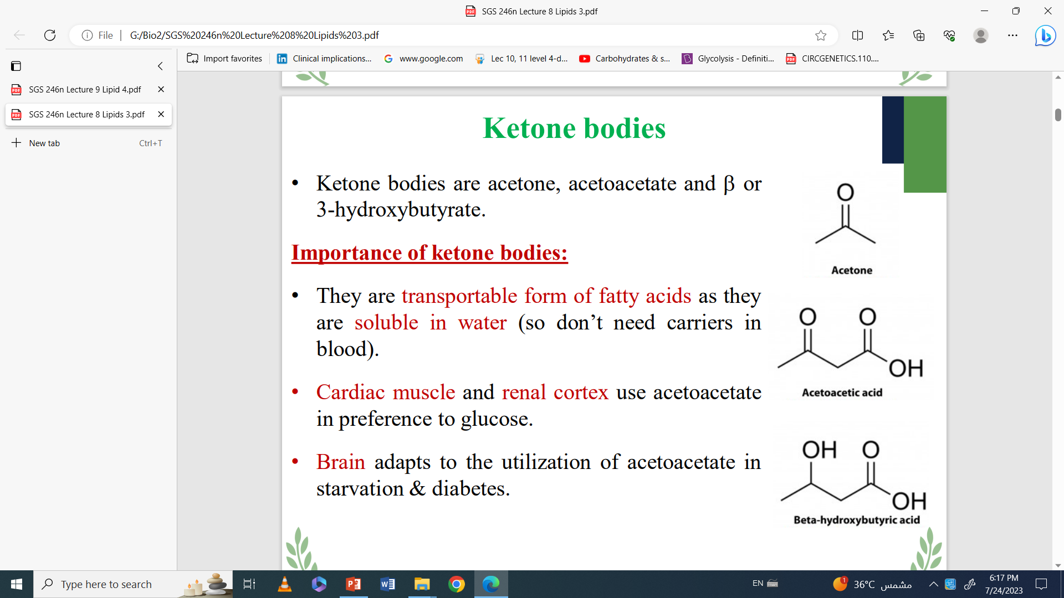
Ketone bodies
Ketone bodies are acetone, acetoacetate and /or 3-hydroxybutyrate.
Importance of ketone bodies:
• They are transportable form of fatty acids as they are soluble in water (so don’t need carriers in blood).
• Cardiac muscle and renal cortex use acetoacetate in preference to glucose.
• Brain adapts to the utilization of acetoacetate in starvation & diabetes

Slide 3
Ketone bodies Metabolism
Ketogenesis
In fasting or diabetes, oxaloacetate is consumed to form glucose by the gluconeogenic pathway and therefore oxaloacetate is unavailable for the condensation with acetyl CoA.
•Under such conditions, liver mitochondria synthesizes ketone bodies from acetyl CoA.

Slide 4
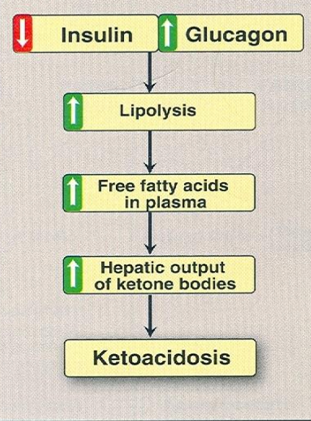
Ketone bodies and diabetes (Diabetic ketoacidosis)
• In diabetes, glucose is abundant in blood but uptake by cells in muscle, liver, and adipose cells is low.
• Cells, metabolically starved, turn to gluconeogenesis and fat/protein catabolism
• In type I diabetics, OAA is low, due to excess gluconeogenesis, so acetyl CoA from fat/protein catabolism does not go to TCA cycle but rather to ketone bodies production leading to acidosis.
• Acetone can be detected on breath of type I diabetics.

Slide 5
Cholesterol
Cholesterol is the characteristic steroid alcohol of animal tissues.
Functions:
1. It is a structural component of all cell membranes.
2. It is the precursor of bile acids, steroid hormones and vitamin D.
3. Component of plasma lipoprotein

Slide 6
Elimination of cholesterol
Excreted in bile.
Converted to bile salts.
•Liver regulates cholesterol homeostasis.
•Normal plasma cholesterol level is < 200 mg/dl.
•Imbalance between cholesterol influx and efflux result in gradual deposition of cholesterol in the tissues leading to atherosclerosis and increased risk of cardiac diseases

Slide 7
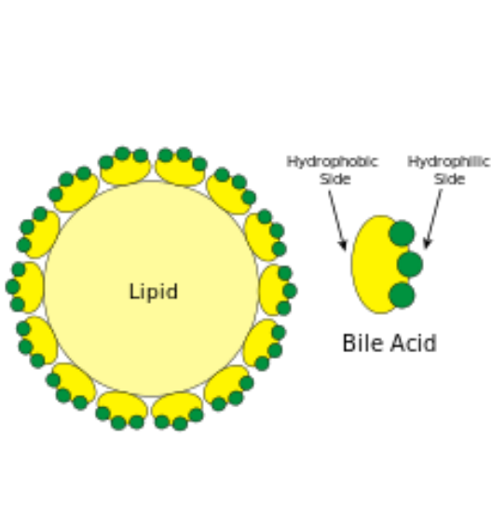
Cholesterol Metabolism
Site: Cytosol of all human tissues, specially liver, intestine, adrenal cortex and reproductive tissues (ovaries, testis and placenta).
Degradation of Cholesterol
The ring structure of cholesterol cannot be metabolized to CO2 and H2O in humans.
The intact sterol nucleus is eliminated from the body by conversion to bile acids and bile salts which are excreted in the feces.

Slide 8
lipoproteins
1- Outer coat consists of a monolayer of protein (apolipoprotein) and polar lipids (phospholipid and unesterified cholesterol).
2- Inner core consists of the hydrophobic lipids (cholesteryl esters and TAG).
Classes of Lipoproteins (Classes of lipoprotein differ in their type of apoprotein and lipid content).
They are classified according to their densities to:
1- Chylomicrons: are the lipoprotein particles lowest in density and largest in size, and contain the highest percentage of lipid and the smallest percentage of proteins.
2- VLDL and LDL: are successively denser, having higher ratios of proteins to lipids. 3- HDL: are the densest, having the highest amount of protein and lowest amount of lipids

Slide 9
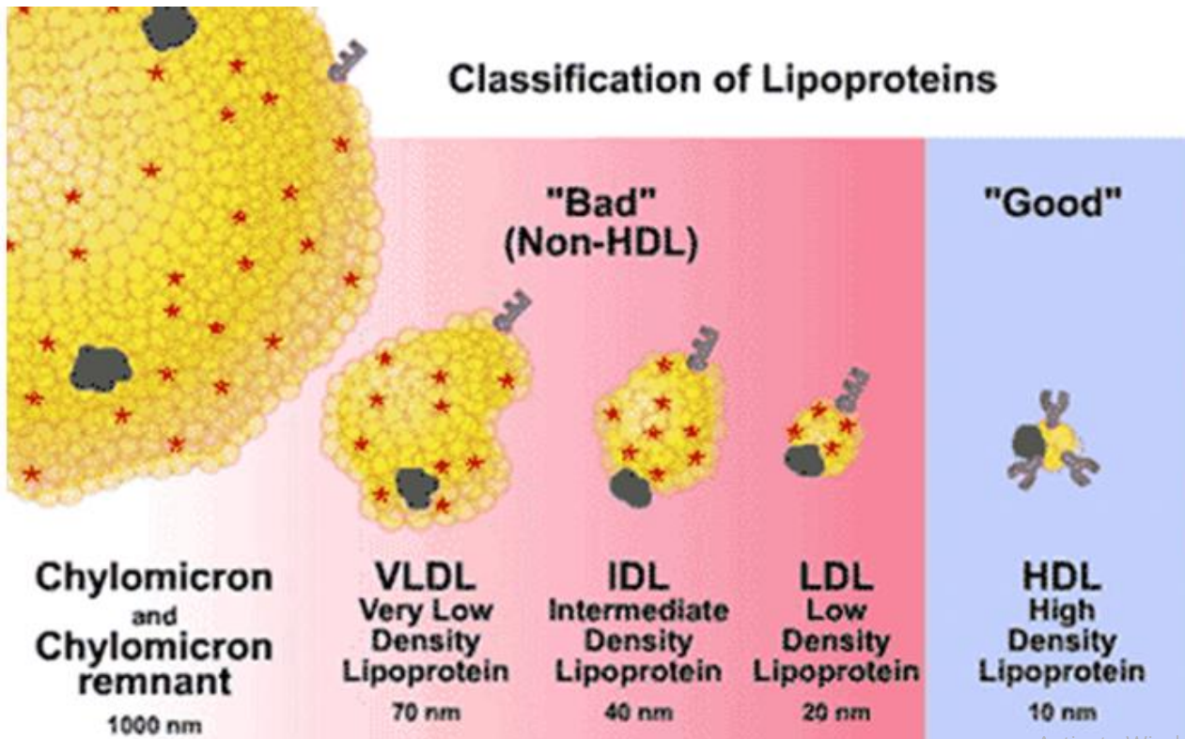

Slide 10
Apoproteins (Apolipoproteins)
Classes:
A, B, C, D, E are major classes
F,M are the minor classes
Subclasses: apo A-1, apo C-II
Functions:
1. Provide recognition sites for cell-surface receptors.
2. Serve as activators or coenzymes for enzymes involved in lipoprotein metabolism.
3. Some of the apolipoproteins are required as essential structural components of the particles and cannot be removed, while others are transferred freely between lipoproteins.

Slide 11
Metabolism of Chylomicrons (exogenous lipids)
Site: intestinal mucosal cells
Function: carry dietary TAG, cholesterol, fat-soluble vitamins, cholesterol esters in addition to lipids made in intestinal cells to peripheral tissues
Assembly of chylomicrons:
The enzymes involved in triacylglycerol, cholesterol, and phospholipid synthesis are located in the smooth ER.
Assembly of the apolipoproteins and lipid into chylomicrons requires microsomal triacylglycerol transfer protein

Slide 12
Metabolism of VLDL
Site of production: Liver
Function: carry endogenously synthesized lipids (mainly TAG) from liver to peripheral tissues

Slide 13
1- Release of VLDL:
VLDLs are secreted directly into the blood from the liver as nascent VLDL particles containing apolipoprotein B-100.
2- Modification of circulating VLDL:
As VLDLs pass through the circulation, triacylglycerol is degraded by lipoprotein lipase (LPL), causing the VLDL to decrease in size and become denser.
Finally, triacylglycerols are transferred from VLDL to HDL in an exchange reaction that transfers cholesteryl esters from HDL to VLDL.
This exchange is accomplished by cholesteryl ester transfer protein

Slide 14
3- Production of LDL from VLDL:
In peripheral tissues, VLDL-TAG are digested by LPL, and VLDL is converted to LDL (intermediate density lipoprotein).
LDL either:
returns to the liver, is taken up by endocytosis by apo E receptor, and is degraded by lysosomal enzymes.
Or form LDL by further degradation.
(LDL reacts with receptors on various cells and is digested by lysosomal enzymes. )

Slide 15
Metabolism of LDL
Composition: mainly cholesterol & cholesteryl esters.
The only apoprotein in LDL is apo B-100.
Function: transports cholesterol from the liver to peripheral tissues.

Slide 16
Metabolism of HDL
Site of production: Liver and intestine.
Functions:
1- HDL is a reservoir of apolipoproteins
• It is a circulating reservoir of apo C-II and apo E .

