Slide 1
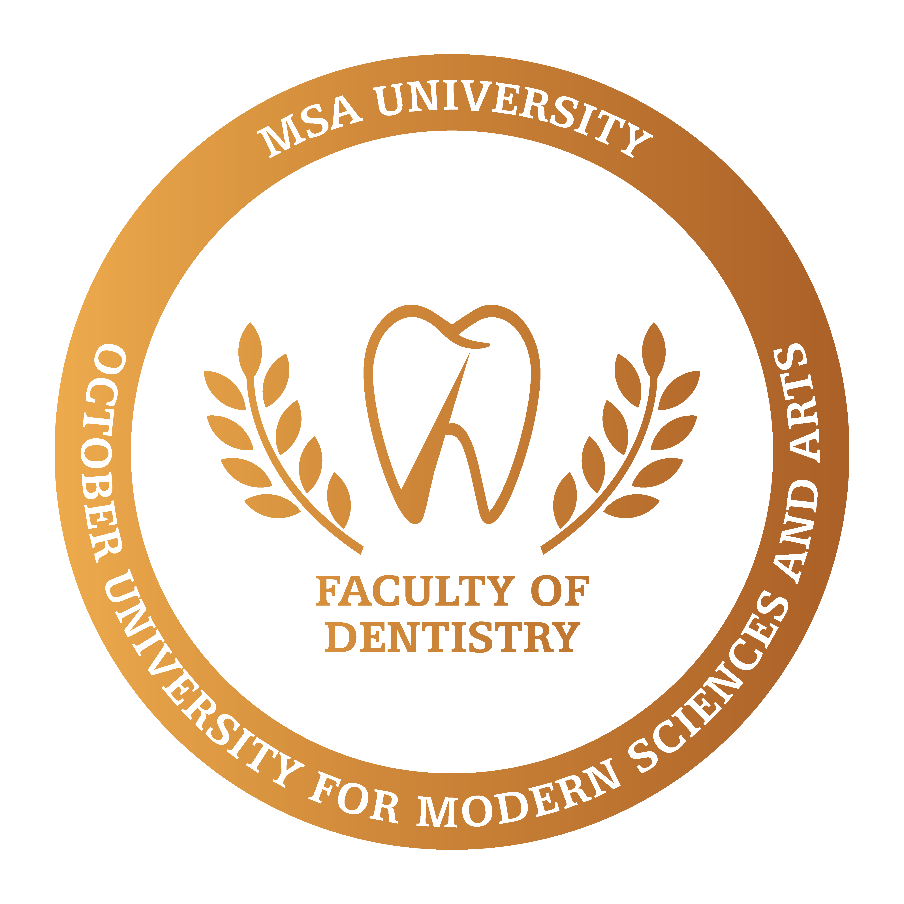
Lecture 1: Carbohydrates Metabolism
Biochemistry Department
Dr. samar elkhateeb
Lecturer of biochemistry and genetics
Smaged@msa.edu.eg

Slide 2
Biomolecules
Carbohydrates
Lipids
Protiens
Nucleic Acids

Slide 3
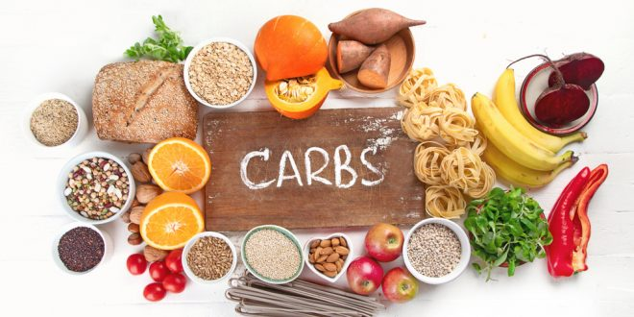
Carbohydrates
A carbohydrate is a biomolecule consisting of carbon (C), hydrogen (H) and oxygen (O) atoms, usually with a hydrogen-oxygen atom ratio of 2:1 (as in water) with the formula Cm(H2O)n (where m may or may not be different from n)
Carbohydrates are the most abundant organic molecule in nature

Slide 4
Functions of carbohydrates
1. Providing significant fraction of energy in diet of most organisms.
2. Acting as a storage form of energy in the body.
3. Cell membrane component that mediates some forms of intercellular communication.
4. Structural component of many organisms (example: cell wall of bacteria, exoskeleton of insects and fibrous cellulose of plants).

Slide 5
Classification of Carbohydrates
Monosaccharides
Carbohydrates that cannot be hydrolyzed to simpler carbohydrates Composed of 1 unit, (examples: glucose or fructose).
Disaccharides
Carbohydrates that can be hydrolyzed into two monosaccharide units (example: sucrose, which is hydrolyzed into glucose and fructose).
Oligosaccharides
Polysaccharides
Carbohydrates that are polymeric sugars
i.e: starch and cellulose
Carbohydrates that can be hydrolyzed into a few monosaccharide units (3-10) .

Slide 6
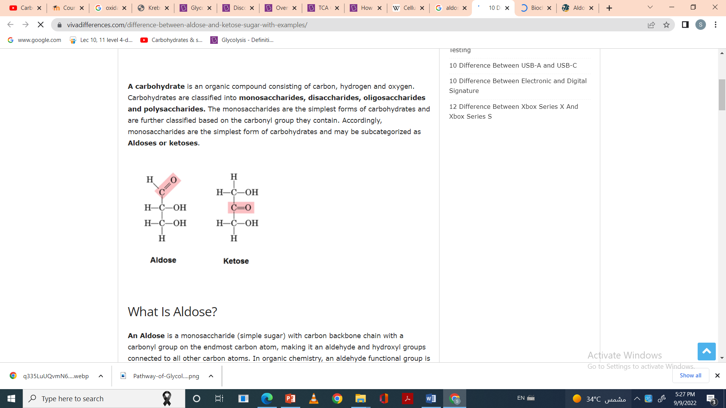
Monosaccarides
They are classified according to the number of carbons in the molecule to:
Trioses (contain 3 carbons)
Tetroses (contain 4 carbons)
Pentoses (contain 5 carbons)
They are classified into aldoses and ketoses according to the presence of aldehyde or ketone group
Thus we have aldotrioses and ketotetroses …… etc

Slide 7
Importance of some monosaccarides:
Trioses: (Glyceraldehyde-3-phosohate)and (dihyroxyacetone phosphate)are formed during glucose oxidation in living cells.
Pentoses: ribose enters in RNA formation while Deoxyribose enters in DNA formation
Hexoses:
Glucose main source of energy in our body.
Fructose (fruit sugar): forms the disaccharides sucrose together with glucose.
Galactose: forms the disaccharide lactose together with glucose

Slide 8
Polysaccharides
Polysaccharides are polymeric carbohydrates composed of long chains of monosaccharides units.
They form colloidal solutions
Polysaccharides are classified to:
1.Homopolysaccharides (Simple carbohydrates)
2.Heteropolysaccharides (Mixed carbohydrates)

Slide 9
Glycogen:
Is the major form of stored carbohydrates in animals, it Is stored in liver and skeletal muscles.
Each branch contains 8-12 α-D-glucose units linked by α 1,4 glycosidic linkage.
At branching point glucose units are attached to the main chain by α-1,6 glycosidic linkage.

Slide 10
Heteropolysaccharides
mixed polysaccharides which are formed of more than one type of simple sugar units.
Glycosaminoglycans (GAGs) :
GAGs are composed of repeated disaccharide unit composed of:
1.Amino sugar
2.Sugar acid

Slide 11
Properties and functions:
1-Gel-like matrix:
GAGs are polyanionic (several negative charges) due to carboxylic and sulfate groups.
they attract cations as sodium and thus attract water.
Molecules bind to water and form gel-like matrix.
Its function is to support cellular and fibrous components of connective tissues

Slide 12
2-Slippery consistency:
Due to several negative charges GAGs molecules rebel each others leading to slippery consistency.
• Its function is to produce slippery consistency of mucous as well as lubricating property of synovial fluid.

Slide 13
3-Shock absorbing properties:
Because GAGs bind to large amounts of water, when the GAGs are compressed water squeezes out and GAGs occupy smaller volume. • When compression is released GAGs are hydrated and regain original volume.
• Its function is the resilience of synovial fluid and vitreous humor of the eye.

Slide 14
Examples of GAGs
Hyaluronic acid (Serves as a lubricant and shock absorber, found in loose connective tissue, eyes and in synovial fluid in joints)
Chondroitin sulfate (The most abundant GAG in the body,found in cartilage, ligaments and tendons. Used for osteoarthritis to help building cartilage)
Dermatan sulfate (Found in skin, arterial smooth muscles and heart valves.)
Keratansulfate ( Found in the eye.)
Heparin (anticoagulant)
Heparan sulfate (Found in basement membrane of blood capillaries and plays an important role in protein cell signaling.)

Slide 15
Metabolism
Metabolism is either catabolism or anabolism.
Catabolism: degradative pathways, usually energy-yielding!
Anabolism: biosynthetic pathways, energy requiring.

Slide 16
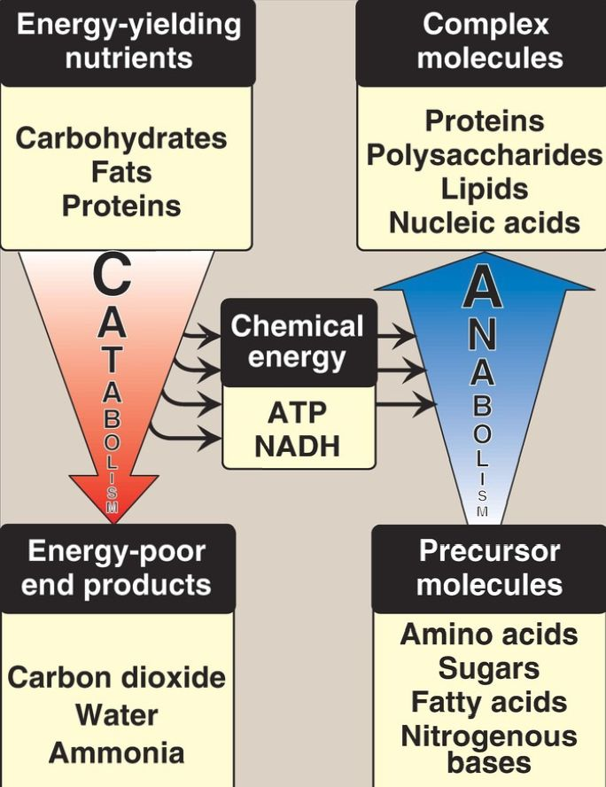

Slide 17
Cellular respiration
Cellular respiration may be described as a set of metabolic reactions and processes that take place in the cells of organisms to convert chemical energy from nutrients into Adenosine triphosphate (ATP), and then release waste products.
Respiration involves 3 main process:
Glycolysis.
Decarboxylation of pyruvate to acetyl CoA.
Krebs cycle.

Slide 18
Blood glucose can be obtained from 3 sources:
1- Diet: Dietary intake of glucose and glucose precursors, such as starch, monosaccharides and disaccharides, it is depending on the diet, so it is not always a reliable source of blood glucose.
2- Gluconeogenesis: It can provide sustained synthesis of glucose, but it is slow in responding to the decrease in blood glucose level.
3- Glycogenolysis (degradation of glycogen): it is the mobilization of the storage form of glucose which is “glycogen” .

Slide 19
Key Points of Glycolysis
Glyco ➔ Glucose Lysis ➔ Breakdown
It is the primary step of cellular respiration process in which a glucose molecule is broken down into two molecules of pyruvate.
The process takes place in the cytoplasm of plant and animal cells.
The end products of the reaction include 2 pyruvate, 2 ATP and 2 NADH (=6ATP) molecules total (8 ATP).
Glycolysis is followed by the Krebs cycle during aerobic respiration. In the absence of oxygen, the cells make small amounts of ATP as glycolysis is followed by fermentation.
Notes:
Occurs under aerobic AND anaerobic conditions • All steps are reversible except 3
Ten reactions; same in all cells but differ in rates.
Two phases: ▪ First phase converts glucose to Glucose-6-P (energy investment phase) ▪ Second phase produces two pyruvates (energy generation phase)
N.B.: Magnesium is required for kinase reactions.
The pyruvate is not transported into the mitochondrion but remains in the cytoplasm, where it is converted to waste products that may be removed from the cell.
This waste product varies depending on the organism. In skeletal muscles, the waste product is lactic acid. This type of fermentation is called lactic acid fermentation

Slide 20
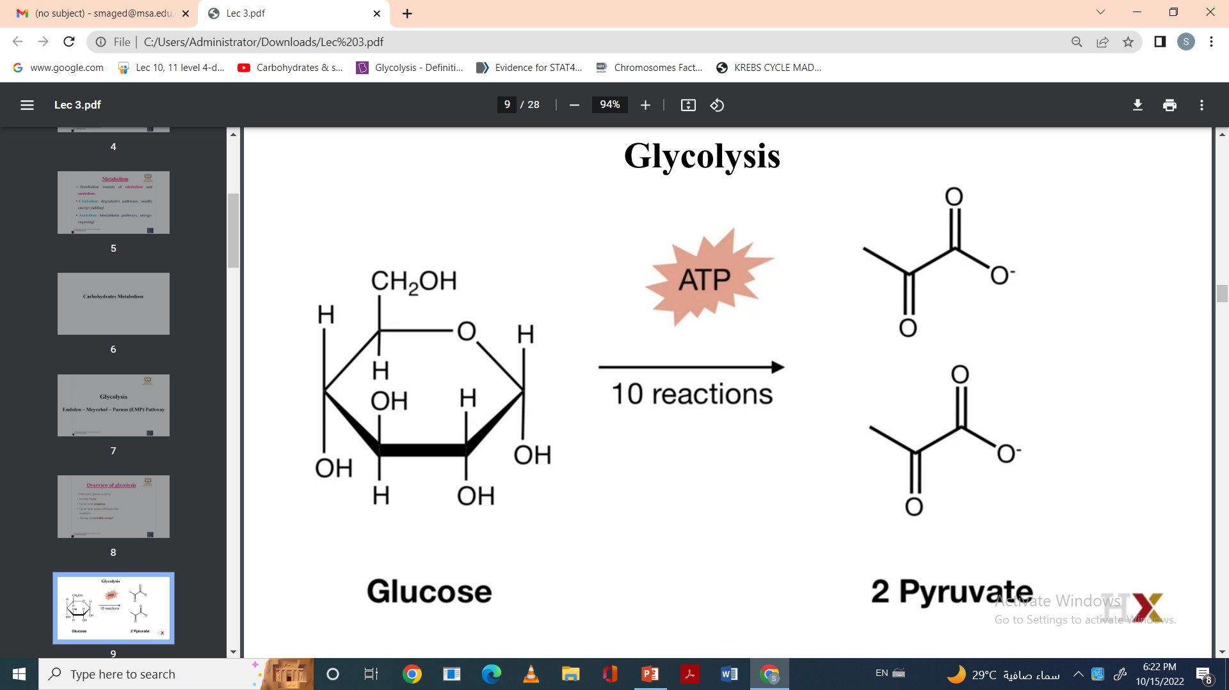

Slide 21
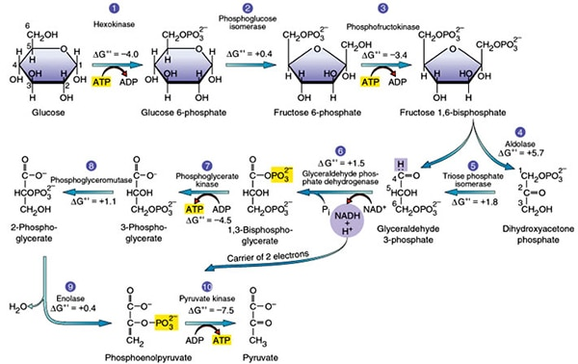

Slide 22
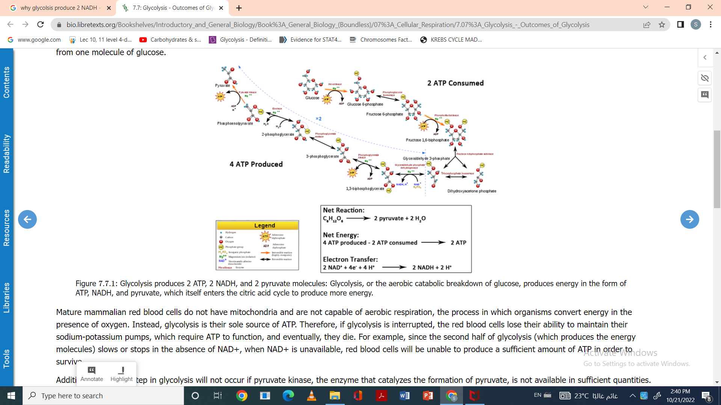

Slide 23
Regulation of Glycolysis
Allosteric regulation
Glycolysis is primarily regulated in response to cells requirement for ATP.
Regulatory enzymes are:
Hexokinase.
PFK-1(phosphofructokinase 1)
Pyruvate kinase.
Hormonal regulation
Hormonal regulation is slow, affect on enzyme synthesis. By hormones such as ( insulin and glucagon)

Slide 24
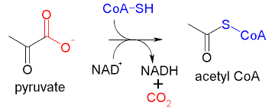
Decarboxylation of one pyruvate to acetyl CoA.
Pyruvate is transported cross inner mitochondrial membrane by specific transporter.
In the matrix, pyruvate is irreversibly decarboxylated by a multienzyme complex.
Five coenzymes are needed (Pyruvate Dehydrogenase complex)
Out put : 1 NADH (3ATP)

