Slide 1
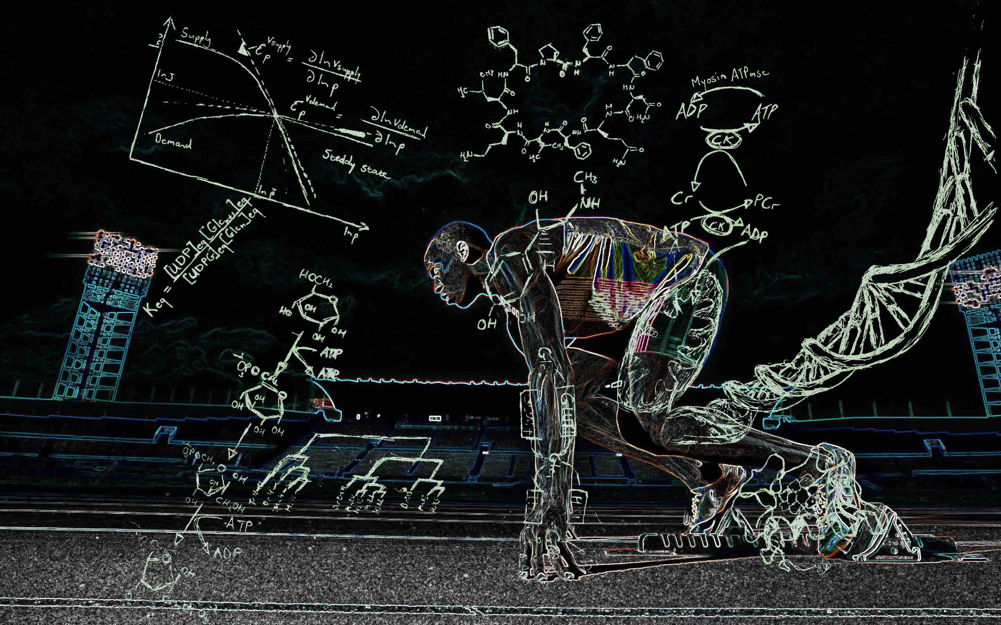
Biochemistry Department
Faculty of Dentistry

Slide 2


Slide 3
Cholesterol is synthesized in liver then intestine and can be found in diet.
Normal range: 150-200 mg/dl
Hypercholesteremia: more than 220 mg/dl
Hypocholestremia : less than 120 mg/dl

Slide 4
Cholesterol
Main component of cell membrane (phospholipids)
Synthesis of (Derivatives):
1- Steroid hormones
2- Plasma lipoproteins
3- Vitamin D3
4- Bile salts and acids

Slide 5
Synthesis
Acetyl CoA
HMG Co A reductase
Cholesterol

Slide 6
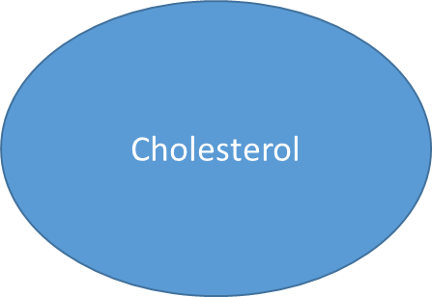
Hypocholesteremia
Hyperthyroidism
Bile salts
Hypercholestremia
Hypothyroidism

Slide 7
Hypercholestremia Causes
Diet rich in carbohydrates
Diet rich in fats
Smoking and coffee
Diabetes
Hypothyroidism
Obstructive jaundice
Nephrotitis

Slide 8
Hypocholesteremia Causes
Liver disease
Diet poor in fats and carbs
Hyperthyroidism

Slide 9
Complications:
Atherosclerosis and coronary heart disease.

