Slide 1
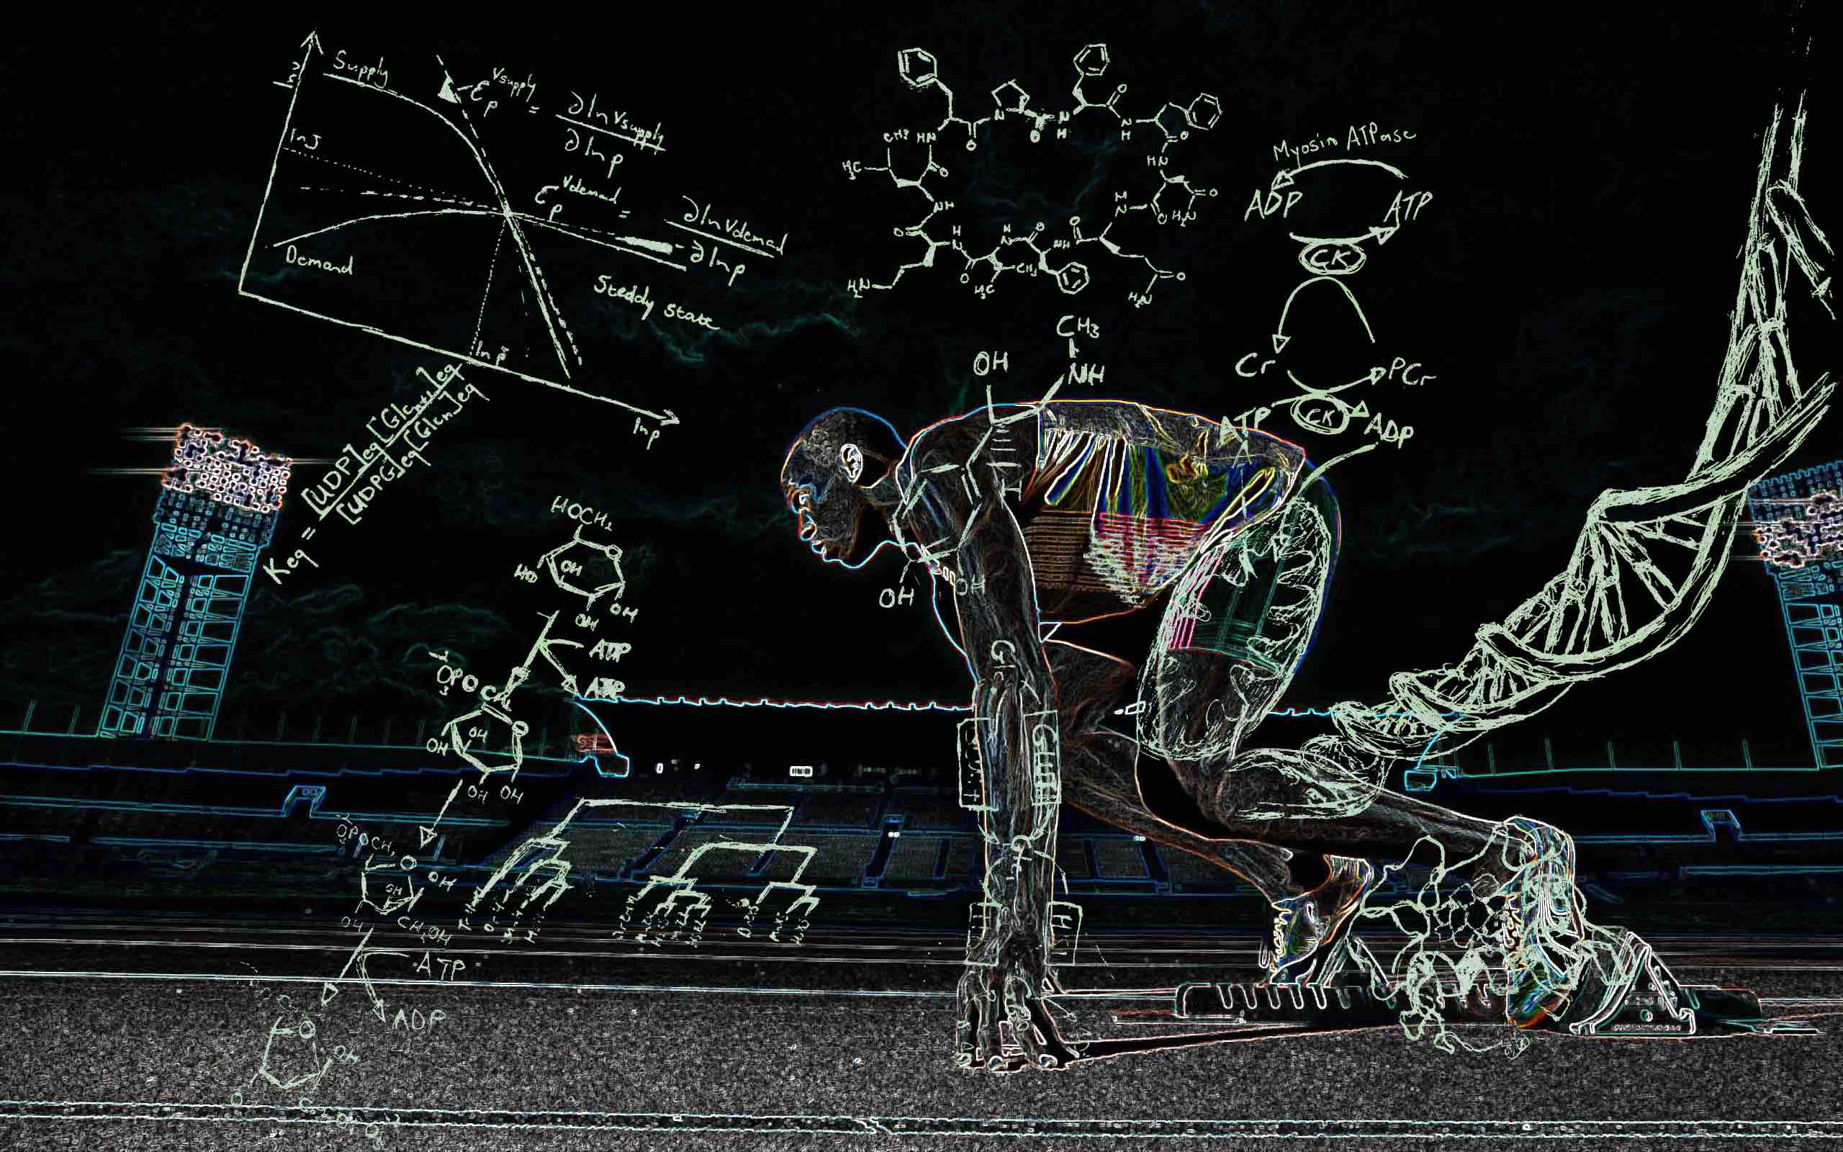
Biochemistry Department
Faculty of Dentistry

Slide 2
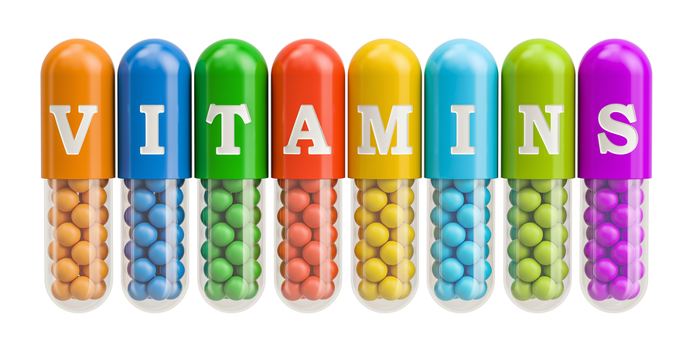
Required in low amounts
Can not be synthesized in our bodies except for vit K
Must be included in diet

Slide 3
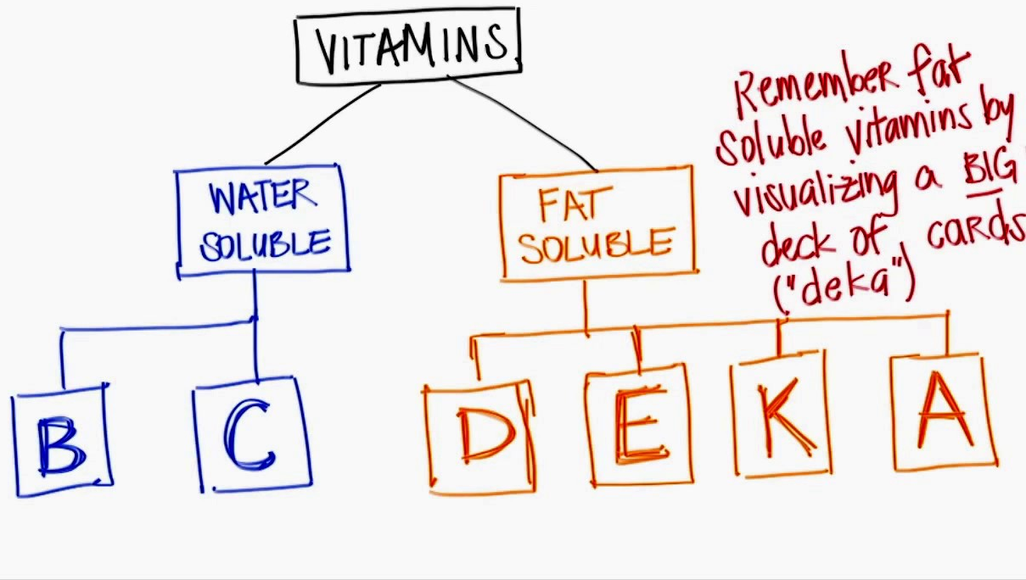

Slide 4
Vitamin C= Ascorbic acid functions
1-Help in collagen formation
2-Maintains blood vessels, bone and teeth
3-In production of hormones from brain and adrenal cortex
4-In absorption of folic acid, calcium and iron
5-It is a water soluble anti-oxidant

Slide 5
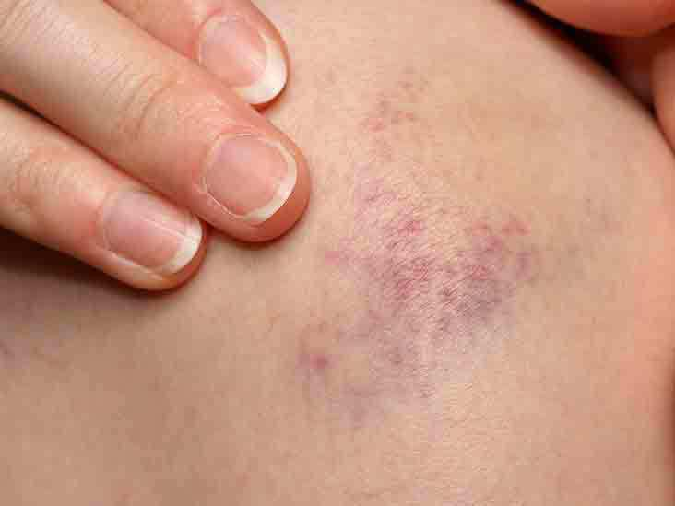
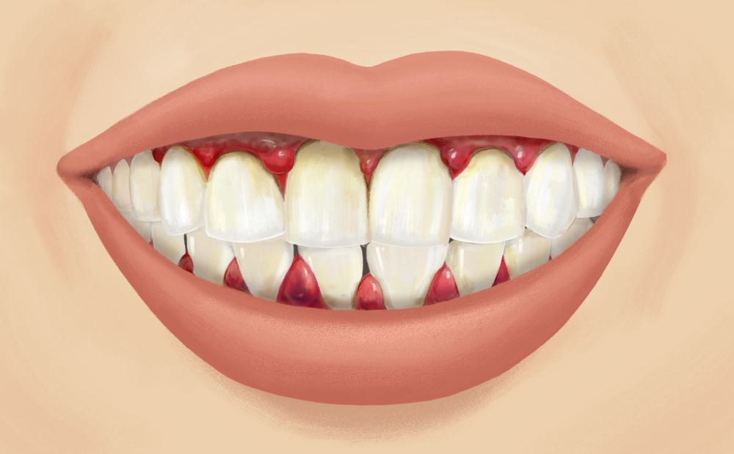
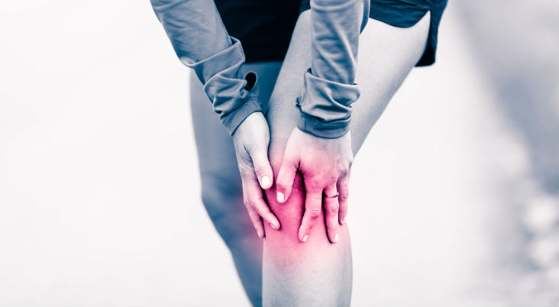
Vitamin C deficiency= Scurvy disease
1-Defect in collagen formation which will lead to swollen gum and bleeding as well as sore joints, subcutaneous petechial hemorrhage, and decreased healing power
2- Anemia due to hemorrhage and poor absorption of iron

Slide 6
Vit A= Retinol function
1-Maintains healthy epithelial tissue such as in skin and mucus membrane
Deficiency in vit A will lead to low mucus production (glycoprotein) and that will cause rough skin
2-it helps in night vision as it converts retinol to retinoic acid. In addition the retina has rhodopsin which is attached to vit A to aid in night vision
Deficiency in vit A will lead to a problem in night vision due to the non functioning rhodopsin protein

Slide 7
3- helps in bone and teeth development
4-has an anti oxidant property

Slide 8
Vit A deficiency manifestations
Dry mucus membrane
Infections of the respiratory tract and GIT
Rough skin
Night blindness
xerophthalmia which is dryness of the eye due to atrophy of the lacrimal gland
Corneal opacity
Deformities in bone and teeth as vit A has a role in enamel formation

Slide 9
Vit D= Calciferol function
Hardening of bone
Maintains normal levels of calcium and phosphorus in blood by increasing their absorption from the intestine

Slide 10
Vit D deficiency
Rickets incase of infants
Osteomalagia incase of adults

Slide 11
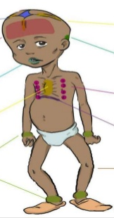
Rickets
Delaying in dentetion
Delaying in closure of fontanels
Pigeon chest
Paw legs and knock knees

Slide 12
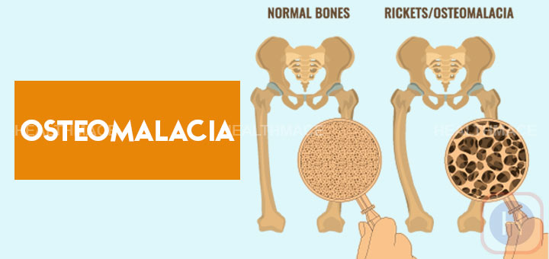
osteomalacia
Fragile weak bones easily fractured due to poor nutrition and repeated pregnancy

Slide 13
Vit E= tocoferol
Anti oxidant that protects from ROS

Slide 14
Vit E deficiency
Sterility and muscle atrophy in rats
Newborn with low body weight may have anemia as a result to the deficiency

Slide 15
Vit K
Can be synthesized by the intestinal flora
Has a role in hemorrhage by the activation of some clotting factors (2,7,9,10)

Slide 16
Vit K deficiency
Bleeding which will lead to anemia and this is very rare

Slide 17
A subject who is complaining of malnutrion developed diarrhea, respiratory and gastrointestinal infections. There was xerophthalmia. The condition was diagnosed as vitamin A deficiency.
Mention:
a. The physiological functions of vitamin A.
b. The sources of vitamin A.
c. What is xerophthalmia?

Slide 18
On examination of a child, there was delayed dentition and delayed closure of the fontanelles. Mention:
a. The diagnosis of the condition.
b. The deficient vitamin in the above condition.
c. Other deficiency manifestations of the vitamin.

